Slide 1
Sprite ordering and
Camera Culling
Aleix Gabarró

Slide 2
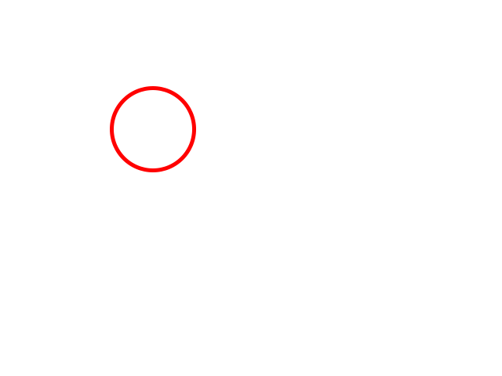
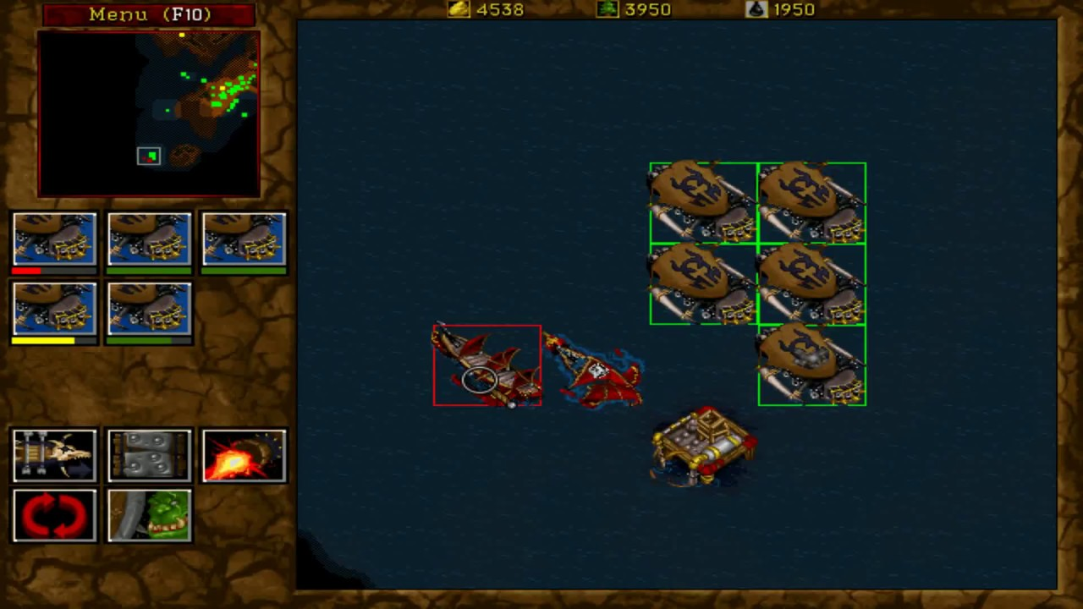
Camera Culling

Slide 3
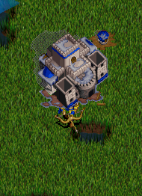
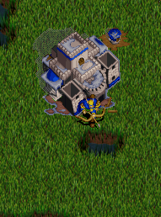
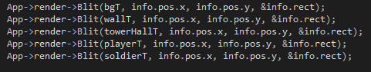
Sprite Ordering

Slide 4
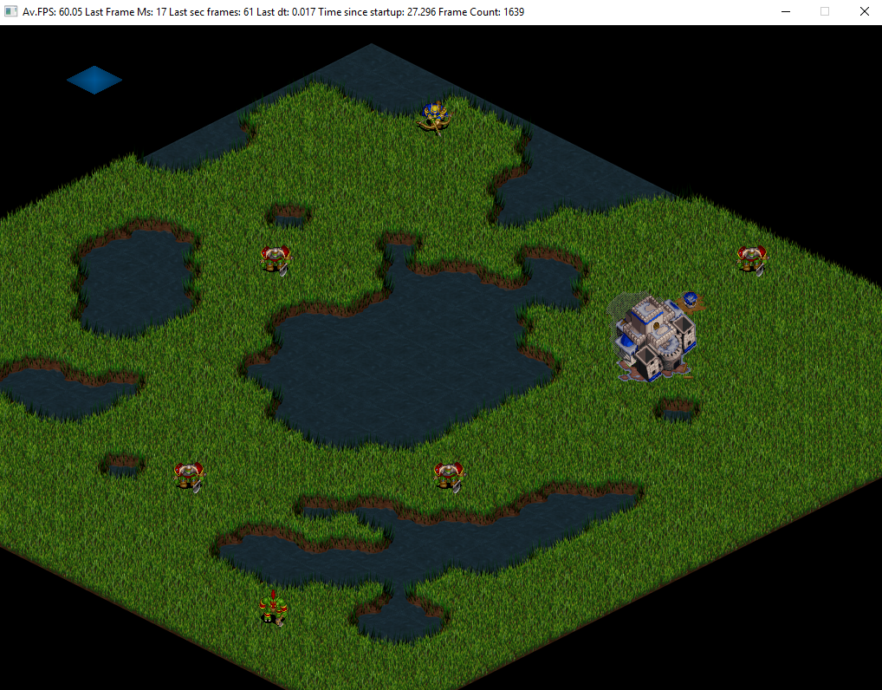
TODO 1
Create a function that says if tile or object position that we want to print is in the screen
Use camera rect to compare
Consider that camera viewport works on the inverse

Slide 5
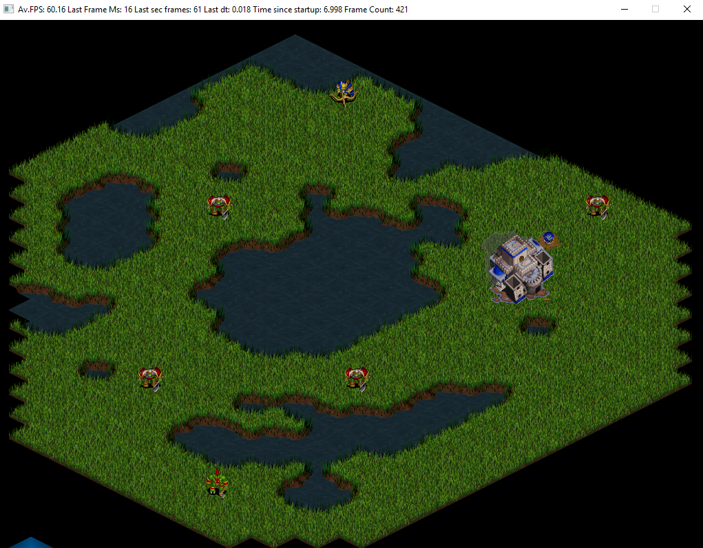
TODO 2
Check if tile position is on the screen with the function that was created during last TODO

Slide 6
TODO 3
Create a struct from entities information
The struct hold:
Rect
Position
Animation
Priority (it's a positive whole)

Slide 7
TODO 4
Create a priority_queue with struct made during last TODO
Third parameter will be done on the next TODO
http://en.cppreference.com/w/cpp/container/priority_queue

Slide 8
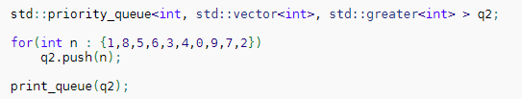

TODO 5
Create a struct that compares entities information priorities
“std::greater” can not be used if there is a struct
Make bool operation inside
http://en.cppreference.com/w/cpp/utility/functional/greater

Slide 9
TODO 6
Iterate entities list and push entities information in the priority queue
Take into account the first TODOs from Camera Culling
Don’t push in the queue if entity is not in the screen
Assign all information before push in the queue

Slide 10
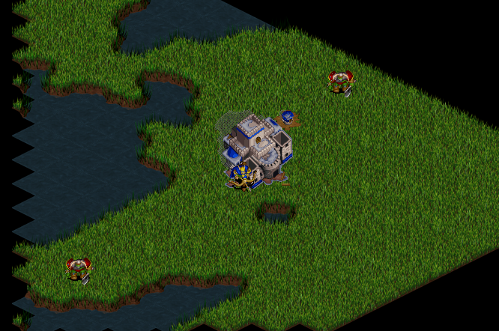
TODO 7
Pop queue and blit one by one
Comment “(*iterator)->Draw(texture);”, it’s few lines above
Blit is different depends on animation

Slide 11
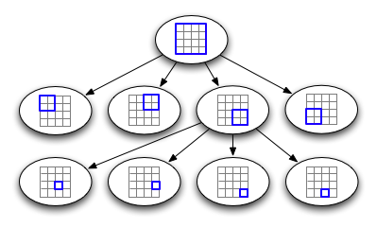
Optional homework
Create a quadtree for your project

Slide 12
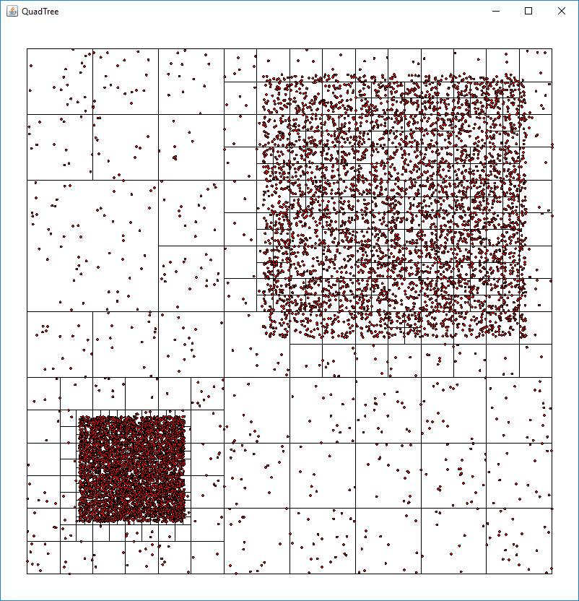
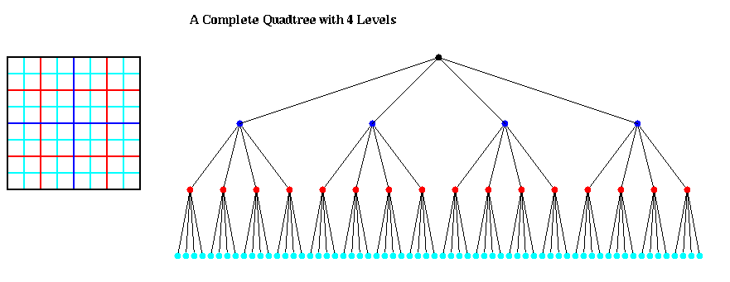
Quadtree
Optimize camera culling
Optimize collisions
Notes:
El quadtree es un arbre en que es separa per nodes fills iguals, es fa servir per casos 2D. Serveix per dividir entre quatre la pantalla i quedar-nos amb els quatre fills, si encara hi ha moltes colisions, printats, es separa en quatre fills mes, que serien els quatre fills del fill anterior i aixi repetitivament.
Exemple al warcraft quan els peons han de portar el material busquen el que tenen mes aprop o quan van a picar pedra, miren el que esta mes aprop en un radi no van al primer que tindrien guardat que potser es a laltre punta del mapa

